Slide 1

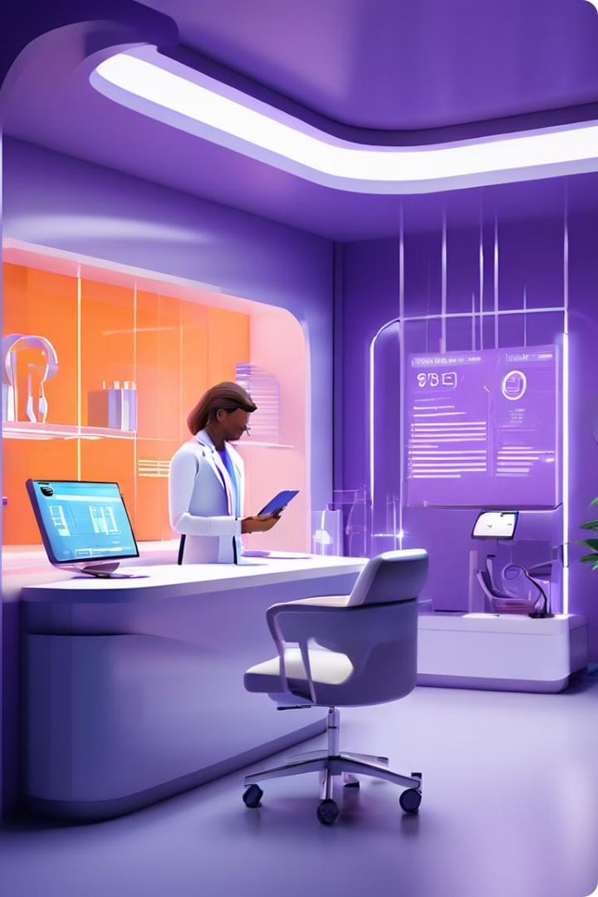
TALK-TO-DIAGNOSIS
An AI system which provides and brief understanding regarding patients previous medication. As well as validation for the prescription.
This presentation outlines the development of an AI system that analyzes patient data to create personalized treatment plans, aiming to improve healthcare outcomes.
By Team: DigiCare

Slide 2

Introduction to the Problem
Current treatment plans are often generalized, failing to account for individual patient variations, leading to less than optimal outcomes.
1
Inefficient Treatments
Traditional approaches often overlook patient-specific factors, leading to ineffective treatments.
2
Increased Costs
Inefficient treatments can lead to prolonged hospital stays and unnecessary medical expenses.
3
Patient Dissatisfaction
Generalized plans may not address individual needs, resulting in patient dissatisfaction and reduced adherence.

Slide 3

Proposed AI Solution
Our AI system analyzes patient data, such as medical history, lifestyle factors, and genetic predispositions, to identify personalized treatment options.
Data Analysis
Treatment Recommendations
Continuous Monitoring
The system utilizes machine learning algorithms to analyze vast amounts of patient data, identifying patterns and trends.
The system continuously monitors patient progress, adjusting treatment plans as needed to optimize outcomes.
Based on data analysis, the system generates personalized treatment recommendations tailored to each patient's unique characteristics.

Slide 4

Data Collection and Preprocessing
Data is collected from various sources.
1
Data Integration
Data from different sources is integrated into a unified database, ensuring consistency and accuracy. Here we used excel itself for our database as hosting in localhost itself.
2
Data Fetching
The data is fetched and calls out the respective patient data itself.
3
Data Transformation
Data is transformed into a format suitable for machine learning algorithms, here we converted into json file and csv files.

Slide 5
Machine Learning Model Development
Advanced machine learning algorithms are used to build predictive models that identify optimal treatment options for individual patients.
Supervised Learning
Unsupervised Learning
Reinforcement Learning
Algorithms learn from labeled data, such as patient medical records and treatment outcomes, to predict future outcomes.
Resource: Kaggile.com
Algorithms identify patterns and relationships in unlabeled data, uncovering hidden insights that may not be readily apparent.
Algorithms learn through trial and error, optimizing treatment strategies based on feedback from real-world patient interactions.

Slide 6

Model Evaluation and Validation
The AI model is rigorously evaluated and validated to ensure its accuracy and effectiveness before deployment.
Metric
Description
Accuracy
The percentage of correct predictions made by the model.
Precision
The proportion of positive predictions that are actually correct.
Recall
The proportion of actual positive cases that are correctly identified by the model.
F1-Score
A harmonic mean of precision and recall, providing a balanced measure of model performance.

Slide 7




Implementation and Integration
The AI system is integrated into existing healthcare infrastructure, allowing for seamless access to personalized treatment plans.
Data Integration
User Interface
Patient Engagement
The AI system integrates with electronic health records, allowing for real-time data exchange and updates.
An intuitive user interface is developed for healthcare providers to access and interpret the AI-generated treatment plans.
The system provides tools for patient engagement, allowing them to track their progress and receive personalized health recommendations.

Slide 8





Expected Outcomes and Benefits
The AI system aims to improve healthcare outcomes, enhance patient satisfaction, and reduce healthcare costs.
Improved Outcomes
Personalized treatment plans are expected to lead to better patient outcomes, including faster recovery times and reduced complications.
Enhanced Patient Satisfaction
Patients are more likely to be satisfied with their care when their treatment plans are tailored to their individual needs.
Reduced Healthcare Costs
Efficient treatment plans can lead to shorter hospital stays and reduced use of medical resources, contributing to cost savings.
Data-Driven Insights
The AI system provides valuable data insights that can be used to improve healthcare practices and develop new treatments.

